Slide 1
NON-RECYCLABLE PLASTIC-A THREAT TO ENVIRONMENT
JAGRUTHI H.B & SHOURYA REDDY .A
CLASS : 8

Slide 2
INTRODUCTION
Plastic is non-biodegradable
Plastics can be recycled / cannot be recycled
It is an inseparable part of our life
Tooth brush
Reduce , Recycle and Reuse

Slide 3
DISADVANTAGES
Non recyclable plastics- cannot be recycled.
Find a safe place in the landfills, landfills fill faster.
Toxins can leach into the soil, water bodies as well as underground water
Plastics are incinerated – dioxin - carcinogen.
Increases the amount of garbage , requires cities to open new landfills and depletes natural resources.
This increases pollution
Plastic waste can block the drains
By eating the food packed in the plastic-kills the animals

Slide 4
OBJECTIVE
To understand the type of plastics used in our house.

Slide 5
SURVEY
CLASS | STRENGTH OF THE CLASS | NUMBER OF STUDENTS BUY MILK PACKETS
10 A1 | 42 | 35
10 A2 | 44 | 32
10 A3 | 47 | 30
9 A1 | 45 | 25
9 A2 | 44 | 31
9 A3 | 43 | 36
8 A1 | 41 | 34
8 A2 | 43 | 35
8 A3 | 41 | 32

Slide 6
INTERACTION WITH SCRAP DEALERS
They don’t take empty milk and oil packets
Rat menace
Landfills

Slide 7
SURVEY
CLASS | STRENGTH OF THE CLASS | NUMBER OF STUDENTS BUY CHILLI PACKETS
10 A1 | 42 | 35
10 A2 | 44 | 38
10 A3 | 47 | 30
9 A1 | 45 | 40
9 A2 | 44 | 38
9 A3 | 43 | 30
8 A1 | 41 | 34
8 A2 | 43 | 30
8 A3 | 41 | 35

Slide 8
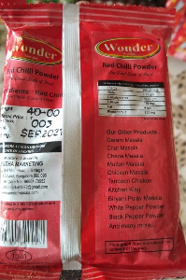
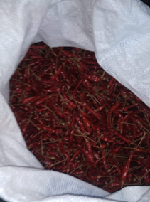
COMPARISON OF PRICE
100g = 40 rupees
1 Kg = 400 rupees (approx)
Whole chilly = 300 rupees
Powdering = 30 rupees
Total cost = 330 rupees
Difference in price is 70 rupees

Slide 9
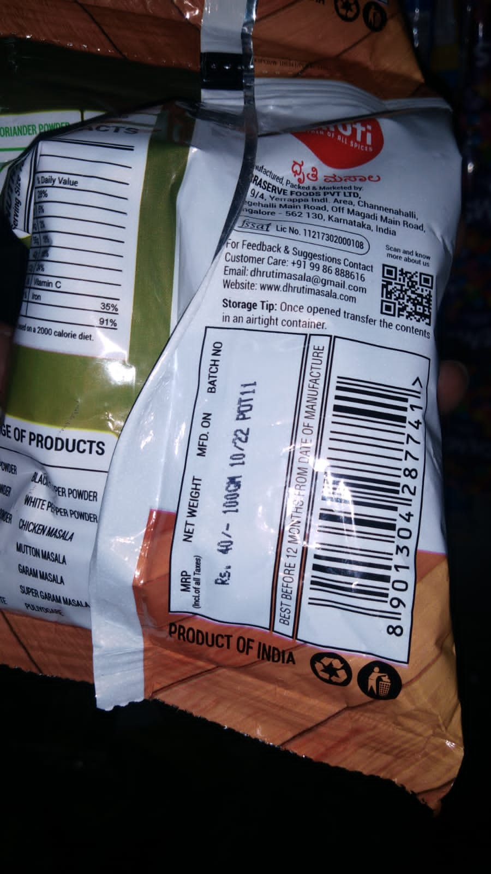
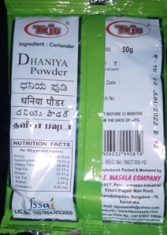
DISADVANTAGES
A minimum of 4 covers go into the landfills monthly
Carcinogenic adulterants

Slide 10
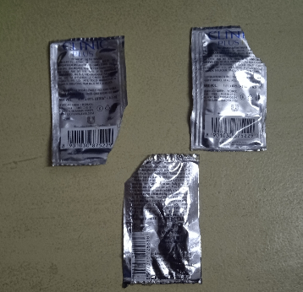
SHAMPOO
Shampoo sachet not bottle.
Non-bio-degradable and non-recyclable.
One family of 4 members
Weekly 3 times head bath
Weekly 12 sachets
Monthly 48 sachets
Yearly 576 sachets
All these go into the landfills

Slide 11
AWARENESS PROGRAMME
We have created an awareness to our school students, teachers and ayahs.

Slide 12
LIST OF HOUSEHOLD ITEMS PACKED IN PLASTICS
Soap , soap powder | Maida flour
Salt | Wheat flour
Chilli powder | Mushroom
Turmeric | All types of spices
Coriander powder | Coffee sachets
shampoo sachet | All types of millets
Biscuit

Slide 13
GREEN LIFE STYLE
Wooden brush
Milk from the milk man
All groceries only wrapped in paper covers
Carry steel containers to get any parcel like idly, panipoori from hotels.
STILL I AM THINKING HOW TO REPLACE BISCUIT COVERS !!!!!!!!

Slide 14
RECOMMENDATIONS
It is always better to buy / powder.
Try to avoid, if possible, packed items instead you can buy them loose in paper covers from the shops.
ADOPT GREEN LIFE STYLE

Slide 15
CONCLUSION
Grocery list- except rice everything come in non-recyclable plastics and all these goes into the landfills.
Government is worried only about plastic carry bags
Company should use bio-degradable plastic to pack
or
TAKE BACK THE PLASTIC THAT THEY PRODUCE.

Slide 16
THANK YOU

